Slide 1
Policy Voter
PJ Ofremu, James Leonard, Chris Chheang, Jason Chong

Slide 2
Purpose
A voting system an organization can use as approval process to adopt new policies
Users are able to write new policies to vote on
Notify users when new policies are available to vote on
Notify users to remind them of current policies being voted on
Store historical voting data
Created for cross platform mobile environment (IOS and Android)

Slide 3
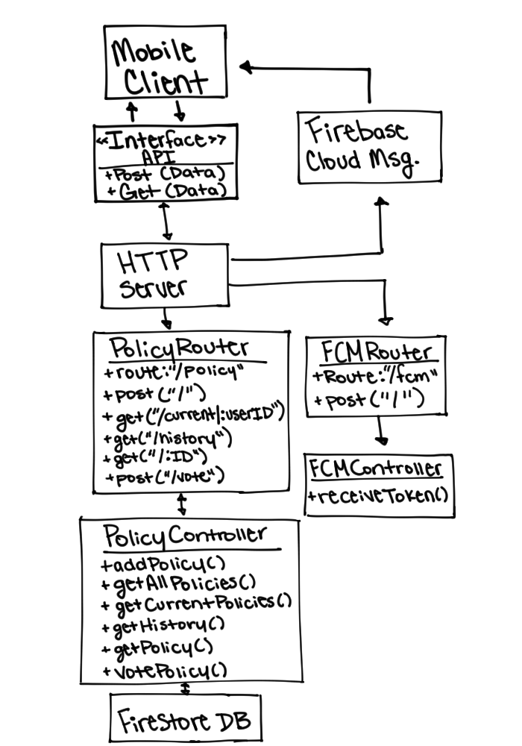
System Architecture
Notes:
Has to be hand drawn

Slide 4
Functional Requirements
The policy voter app will allow users to access their account and view policies currently available for voting.
Users will be able to post a vote to any policies currently available for them for voting.
Users will be able to propose new policies for voting.
The policy voter app will notify all users when a new policy is available for voting
Users will be able to view voting results of previous policies

Slide 5
Non-functional Requirements
When query for current policies is made only current policies not voted by user yet is sent
All details for a new policy, title and description must be provided for a valid request to be made
When a new policy is entered into the Firestore DB a notification is sent to all mobile clients through Firebase Cloud Messaging
When the collective votes on a policy is equal to the number of total users the status for the policy will be changed to COMPLETE
When a policy status is set to COMPLETE a notifications is sent to all mobile clients through Firebase Cloud Messaging

Slide 6
Code and Working System Demonstration
Notes:
Demonstration:
Code:
Server:
Showcase policy routes
Policy Controllers: addPolicy and votePolicy (Point out notifications)
Token controller and notification function
Client:
Policy Utilities: votePolicy, postPolicy
Main.dart: FCM token sent to server on startup
System:
Sign in one device (John)
Vote on Policy
John vote on policy, leave app
Sign in other device (Jane), vote on same policy, leave app
Final vote on policy trigger notification (Show on device, John)
Final vote update status of policy to COMPLETE (Show in DB)
Show completed policy results (John)
Create new policy (John) leave app
New policy trigger notification (Show on device, Jane)

Slide 7
Summary/Experience
All features and functionalities were implemented
Mobile Development was something new, so much learning was done for Flutter and Dart during development.
Interesting challenges such as making sure users don’t see policies already voted on

